Slide 1
Module IV
Behavioural Dynamics:
MARS Model of individual behaviour and performance, Types of Individual behaviour, Personality in Organisation, Values in the work place, Types of values,
Perception :
Meaning, Model of Perceptual process. Emotions in work place, Types of emotions, Circumplex Model of Emotion, Attitudes and Behaviour, Work-related stress and its management.
Motivation:
Meaning, Maslow’s Hierarchy of Needs, Four Drive Theory of Motivation.

Slide 2
Individual-Behavioural Dynamics
Individual behavior means how an employee or Individual behaves, reacts or responds in a given environment.
Combines a set of physical and mental characteristics that reflect how a person looks, thinks, acts and feels about a particular situation.
FACTOR AFFECTING :
Personal Factors (Physical Characteristics , Age, Gender, Ability, Marital Status, Personality, Perception, Attitudes, Values).
Environmental Factors (Economic Factors, Socio-cultural Factors, Legal Environment).
Organizational Factors(Physical Facilities, Organisation Structure, Leadership, Reward System)

Slide 3
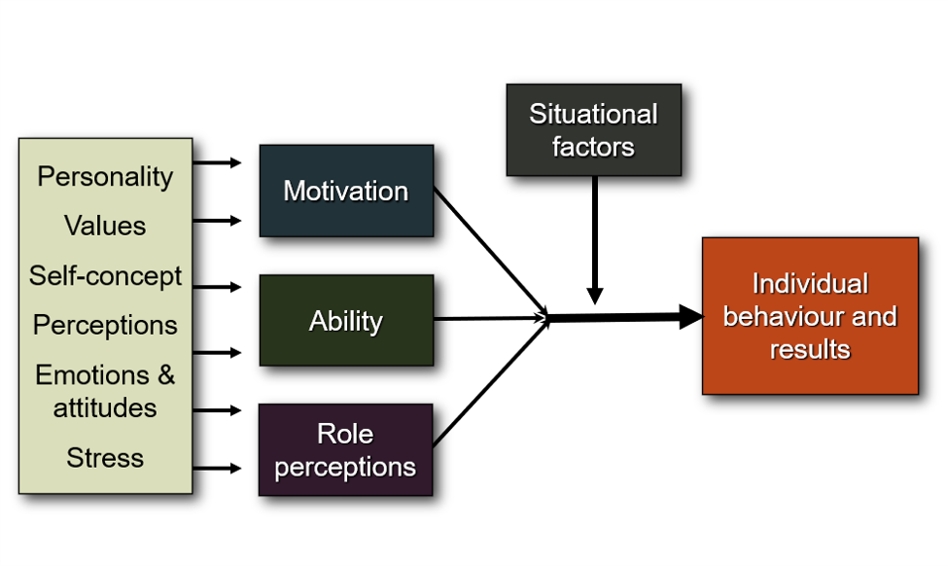
MARS Model of Individual Behaviour and Performance

Slide 4
Types of Individual Behaviour
https://relivingmbadays.wordpress.com/2012/07/29/types-of-individual-behavior/
Task Performance.
Organizational Citizenship.
Counterproductive Work Behavior(Dark side).
Abuse of others (e.g., insults and nasty comments), threats (threatening harm), work avoidance (e.g., tardiness), work sabotage (doing work incorrectly).
Joining and Staying with the Organization.
Maintaining Work Attendance.

Slide 5
Personality in Organizational Behaviour
According to Stephen Robbins – “Personality is a dynamic and organized set of characteristics possessed by a person that uniquely influences his or her cognitions, motivations, and behavior in various situations”.
In Short, Personality is that which permits a prediction of what a person will do in a given situation.
NATURE/ FEATURES OF PERSONALITY:
Consistency.
Impact behaviours and actions.
Uniqueness.
Persistence.
Psychological and physiological.

Slide 6
Values in the Work Place
A person's values are their code of conduct, behavior, beliefs, and principles they live by.
Work values are the combination of priorities, beliefs, ideals, ethics and morals that guide your behavior and decisions in the workplace.
Your work values can relate to the impact of your work on yourself and others, how you accomplish your work or your aspirations.

Slide 7
Types of Values
There are two types of values:
Terminal Values.
Instrumental Values.
Terminal Values :
Terminal Values refer to desirable end-states of existence, the goals a person would like to achieve during his or her lifetime.
They include happiness, self-respect, recognition, inner harmony, leading a prosperous life, and professional excellence.

Slide 8
Instrumental Values :
Instrumental values are an expression of competence and guide the selection of means to be used to obtain the end states of existence.
It includes being honest, sincere, ethical and ambitious.
Terminal values denote beliefs regarding a desirable end state, that is, the state that ought to be achieved. Instrumental values refer to beliefs regarding a desired mode of conduct, that is, how to achieve that end state.

